Slide 1
The European eInfrastructures Observatory Ημέρες Ευχρηστίας και Προσβασιμότητας 2012 Δαΐς Πολιτιστικό & Αθλητικό κέντρο, 06.11.2012
Νεκταρία Μπερίκου
n.berikou@enventory.eu

Slide 2
Need and Vision
eInfrastructure stakeholders and providers need a tool / service for
prospective, i.e. ex-ante evaluation/assessment and retrospective, i.e. interim or ex-post evaluation and monitoring of related eInfrastructure initiatives and programmes
reporting the diversity and scope of their resources and their usage to funders and decision makers at national and European levels
e.nventory ‘s vision was the formation of the European eInfrastructures Observatory:
an online, single-entry-point platform
offering interactive, user-driven visualisation tools, and
an extensive set of benchmarking indicators
geographically addressing Europe in order to:
facilitate multidimensional and polymorphic monitoring and analysis
support fact-based policy and learning, and
disseminate achievements of eInfrastructures in Europe and beyond

Slide 3
Current status
Offers 7 intuitive, interactive and user-friendly visualisation tools based on best practices in visualisation and representation techniques
Features a core set of more than 45 benchmarking indicators that are the baseline for monitoring eInfrastructures development progress, usage, impact and investments
Provides access to more than 10.000 individual figures and other related data and benchmarks
Consolidates more than 18 months of stakeholders’ feedback and consensus on the structure and functionality of a world-class eInfrastructures Observatory

Slide 4
Steps
First Period
In-depth survey of information visualisation (InfoViz) representation and interaction techniques for data indicators
Examination of reference/good examples implemented internationally on three axes: representation, interaction and usability issues
Second Period
Profiling of targeted users and description of related use cases
Policymakers
European Policymakers
National Policymakers
Researchers
European eInfrastructures Observatory prototype web platform requirements and functional specs defined

Slide 5
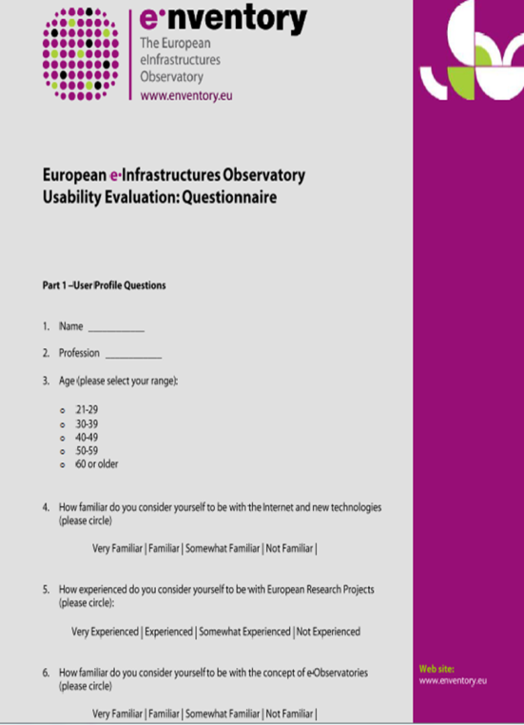
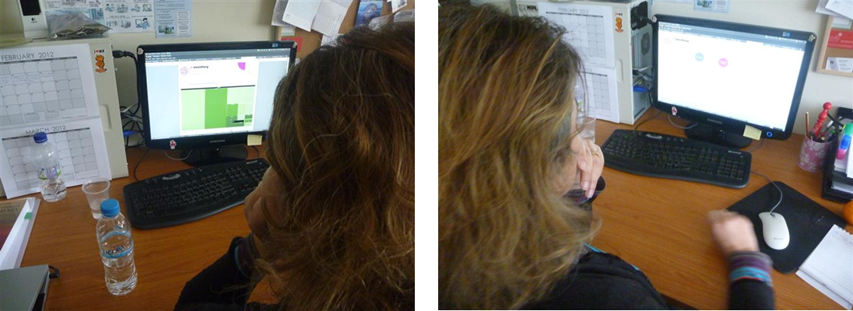
Steps
Third Period
European eInfrastructures Observatory platform and services were designed
Formative usability evaluation study was conducted with one of the targeted use case groups (Researchers) and analysed
Final set of requirements and functional specifications defined, as a direct result of the usability study’s findings
Step-by-step user’s guide developed and made available on-line

Slide 6
Steps
Fourth Period
European eInfrastructures Observatory platform and services were modified and improved following the recommendations
A follow-up in-depth usability evaluation was conducted confirming that the improvements to platform reflected the participants’ comments and needs
The European eInfrastructures Observatory platform was publicly released in June 2012

Slide 7
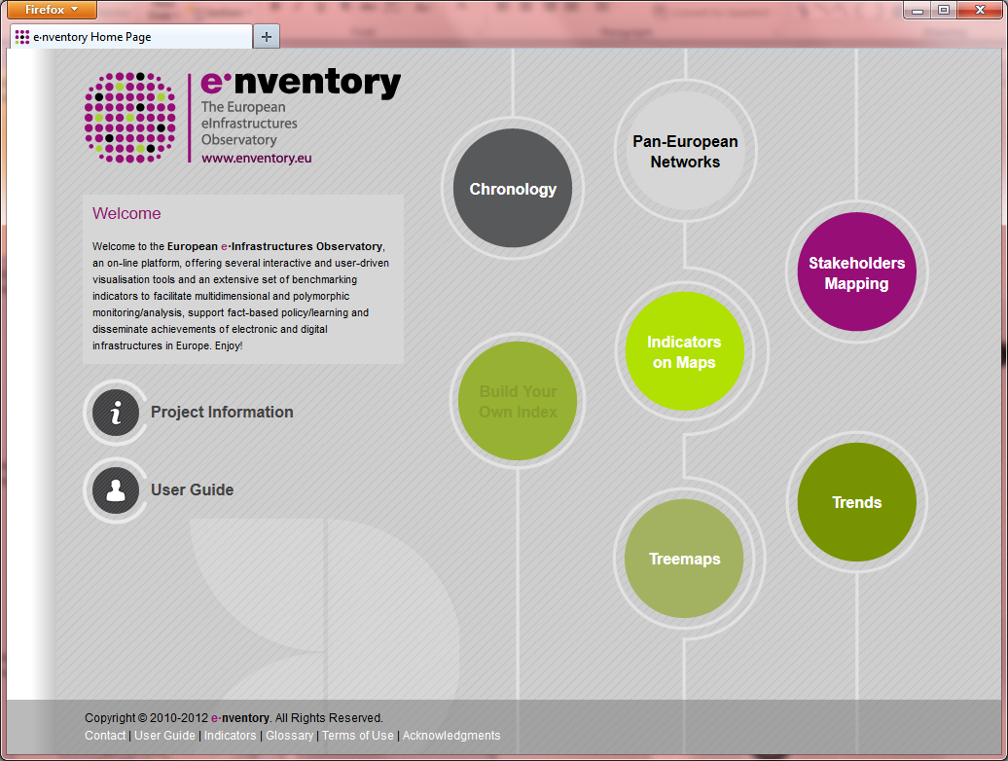
The observatory is public www.e-observatory.eu

Slide 8
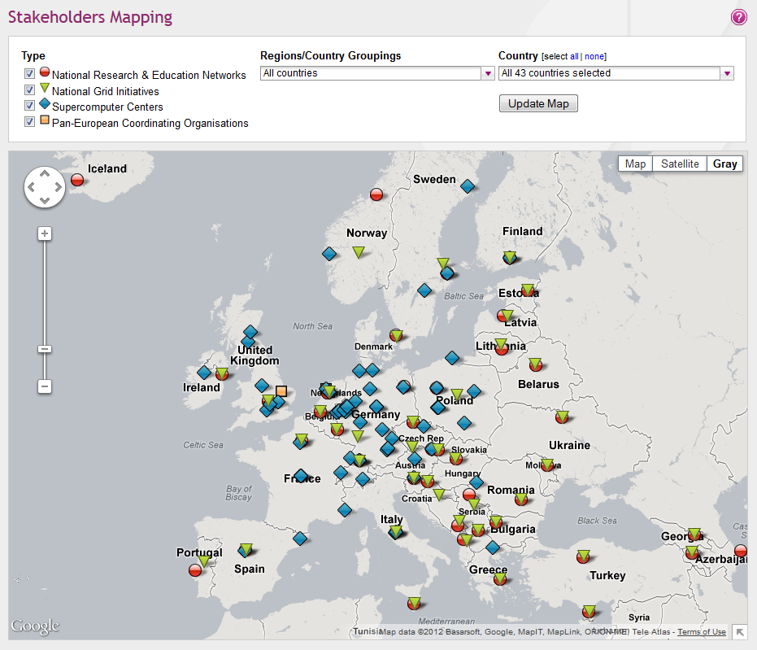
The Stakeholders Mapping service

Slide 9
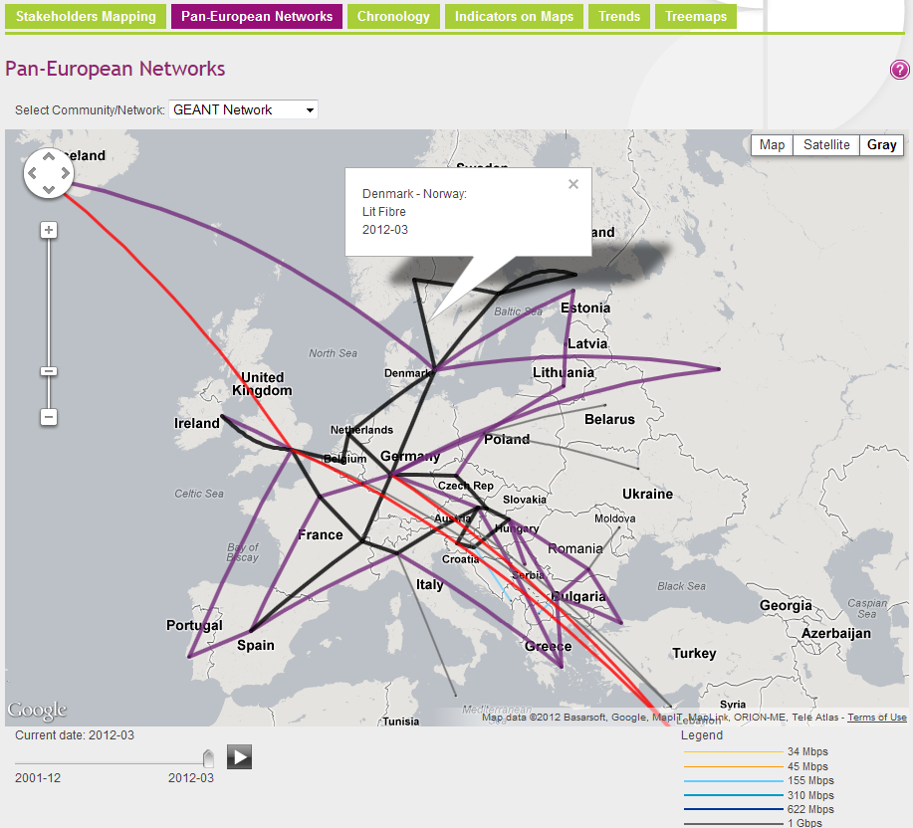
The Pan-European Networks Mapping service

Slide 10
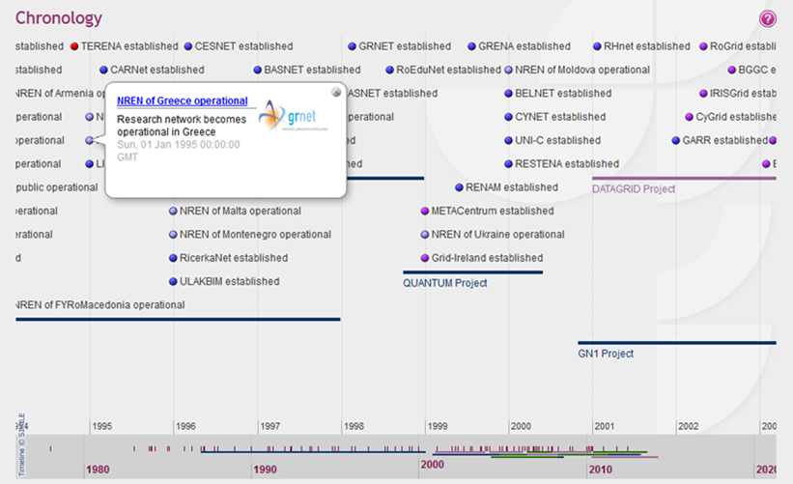
The Chronology service

Slide 11
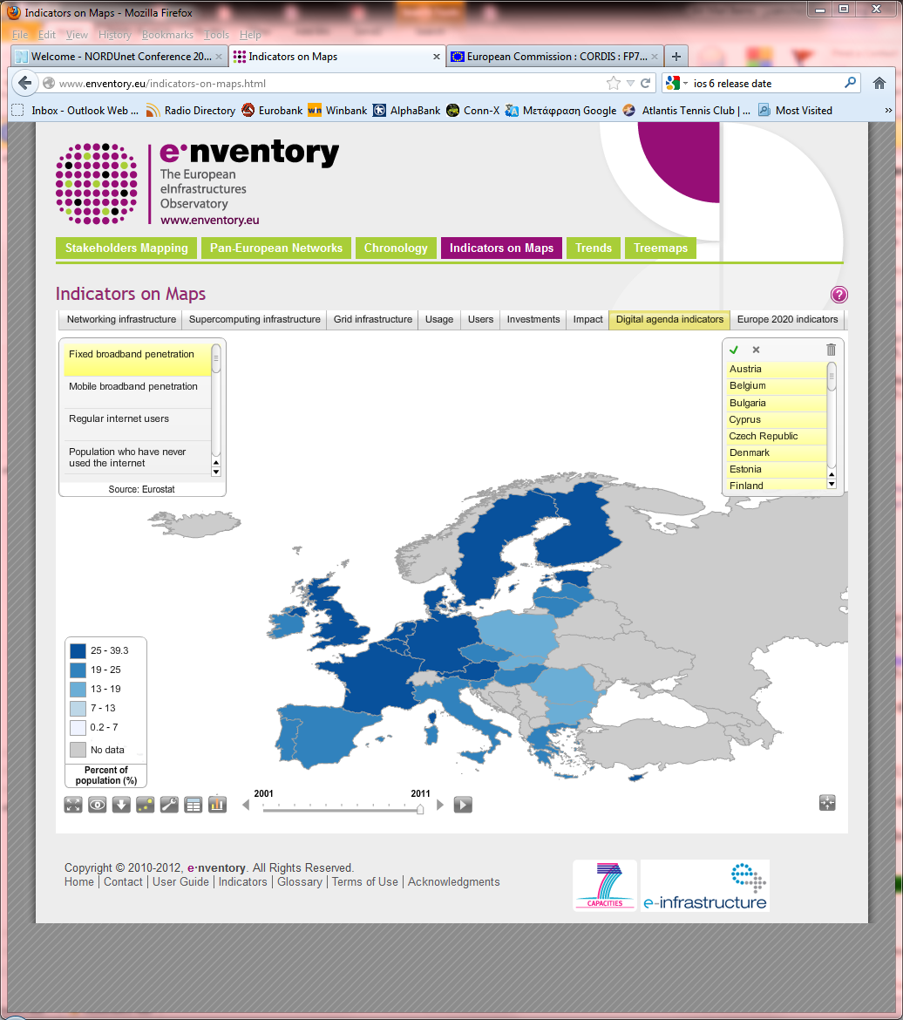
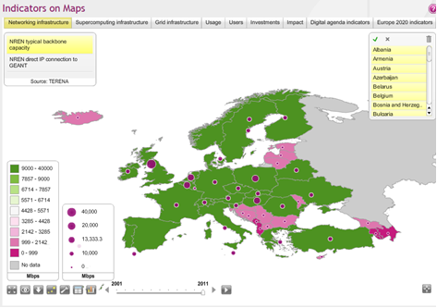
The Indicators on Maps service

Slide 12
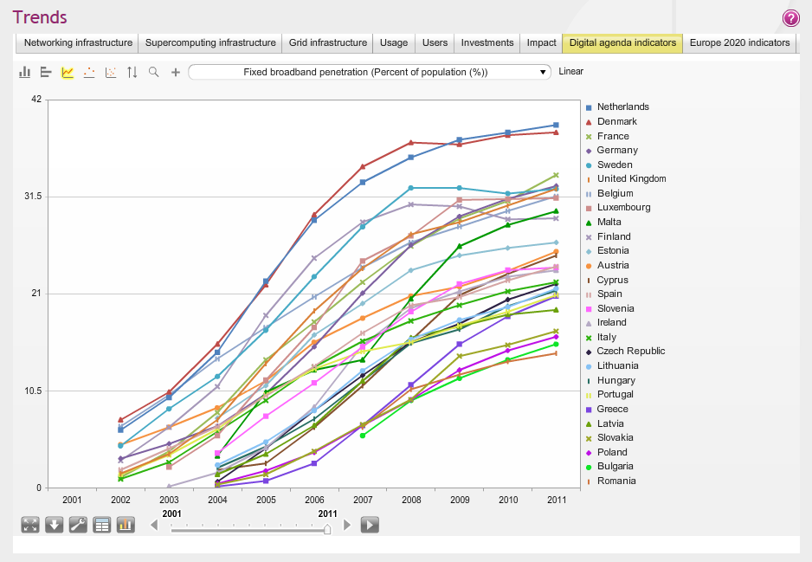
The Trends service

Slide 13
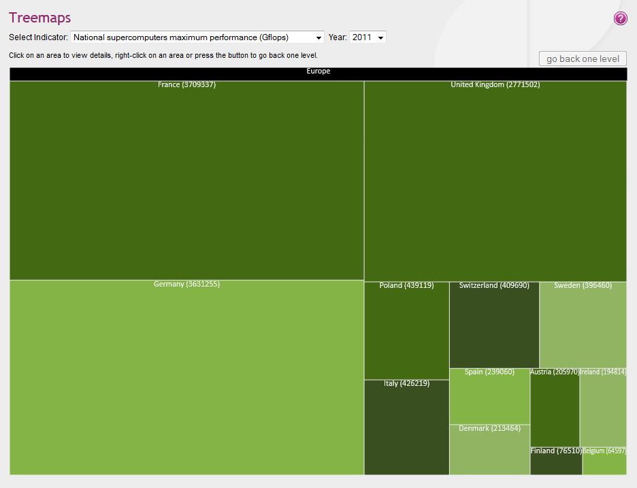
The Treemaps service

Slide 14
www.e-Observatory.eu

Slide 15
Thank you for your attention!
The European eInfrastructures Observatory has been developed by the e·nventory project, co-financed by EU's 7th Framework programme for R&D under Grant Agreement no RI-261554.
The e·nventory project acknowledges the invaluable support and contribution of its Advisory Board and the following European flagship eInfrastructures initiatives and coordinating organisations: GEANT, DANTE, TERENA, EGI.eu, PRACE
Dr.-Ing. Jorge-A. Sanchez-P.
E: info@enventory.eu, T: +30.211.850.1843, F: +30.211.800.1843

